Slide 1

Programming and
Problem Solving
NovoNex Delta
Midterm Question Solving
4 semesters, Summer 2025 (252) to Summer 2026 (262)
1 / 81
Notes:
Question-solving deck for live teaching on a smart TV. Original question excerpts preserve source code and symbols. Read the enlarged excerpt slide(s), then use the working slide for live annotation. Source collection: https://ourdiu.com/questions/courses/257

Slide 2
Programming and Problem Solving
Midterm
Semester index
Summer 2026 (262)
Spring 2026 (261)
8 question groups
9 question groups
Fall 2025 (253)
Summer 2025 (252)
9 question groups
11 question groups
/ Midterm
2 / 81

Slide 3
Summer 2026 (262)
-----------------------------------------------
Midterm Examination
Batch 71
3 / 81
Notes:
Source: https://ourdiu.com/questions/472
Original submission 614
{"id":"legacy-22","username":"foysalhridoy","name":"Md. Ferdous Foysal Hridoy","image":"https://files.ourdiu.com/avatars/10f29923-91bd-45d0-8114-a96eacce3f35"}

Slide 4
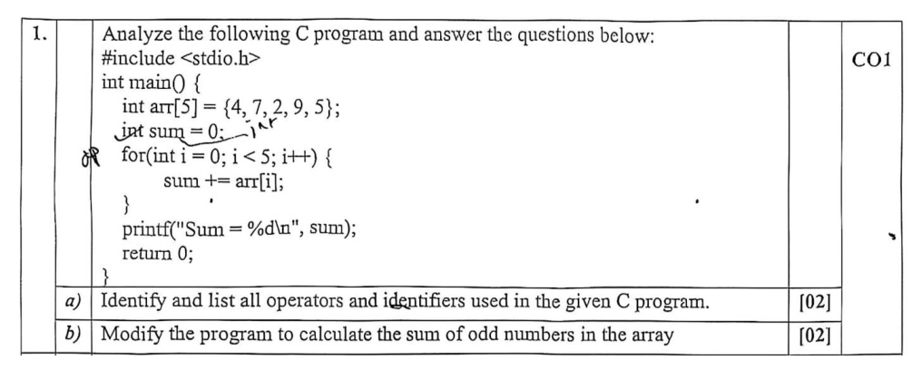
Programming and Problem Solving
Midterm
Q1(a-b) Operators and identifiers
Batch 71
Summer 2026 (262) / Question
4 / 81
Notes:
Source: https://ourdiu.com/questions/472
Original submission 614
Complete question: Q1(a-b) Operators and identifiers
The following slide provides space for live solving.

Slide 5
Programming and Problem Solving
Midterm
Q1(a-b) Operators and identifiers
Batch 71
Working
Summer 2026 (262) / Live solving
5 / 81
Notes:
Source: https://ourdiu.com/questions/472
Q1(a-b) Operators and identifiers
Use the blank area to explain the algorithm, trace variables, or write the solution live. For a larger view of the question, return to the preceding excerpt slide(s).

Slide 6
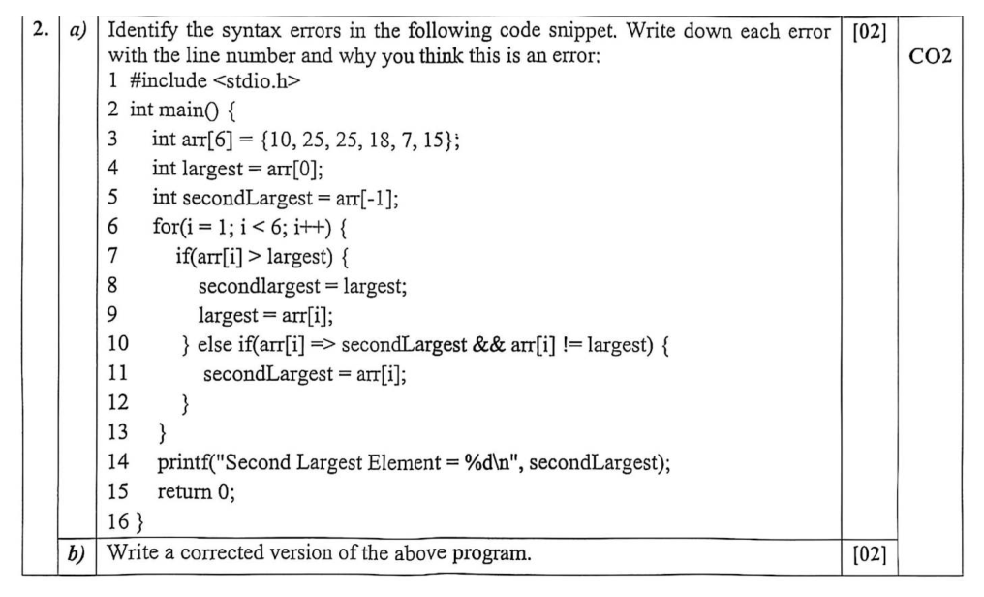
Programming and Problem Solving
Midterm
Q2(a-b) Errors and corrected code
Batch 71
Summer 2026 (262) / Question
6 / 81
Notes:
Source: https://ourdiu.com/questions/472
Original submission 614
Complete question: Q2(a-b) Errors and corrected code
The following slide provides space for live solving.

Slide 7
Programming and Problem Solving
Midterm
Q2(a-b) Errors and corrected code
Batch 71
Working
Summer 2026 (262) / Live solving
7 / 81
Notes:
Source: https://ourdiu.com/questions/472
Q2(a-b) Errors and corrected code
Use the blank area to explain the algorithm, trace variables, or write the solution live. For a larger view of the question, return to the preceding excerpt slide(s).

Slide 8
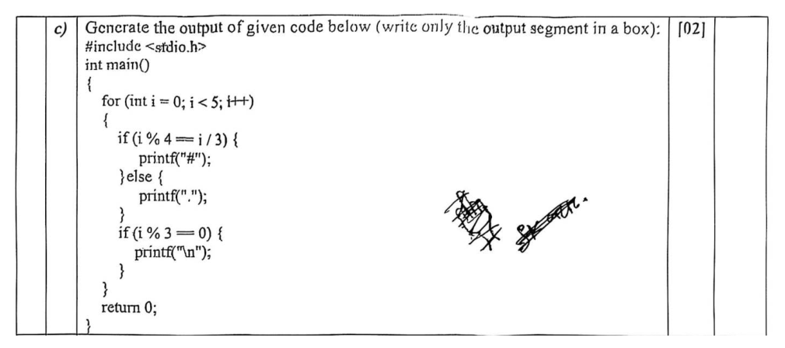
Programming and Problem Solving
Midterm
Q2(c) Output tracing
Batch 71
Summer 2026 (262) / Question
8 / 81
Notes:
Source: https://ourdiu.com/questions/472
Original submission 614
Complete question: Q2(c) Output tracing
The following slide provides space for live solving.

Slide 9
Programming and Problem Solving
Midterm
Q2(c) Output tracing
Batch 71
Working
Summer 2026 (262) / Live solving
9 / 81
Notes:
Source: https://ourdiu.com/questions/472
Q2(c) Output tracing
Use the blank area to explain the algorithm, trace variables, or write the solution live. For a larger view of the question, return to the preceding excerpt slide(s).

Slide 10
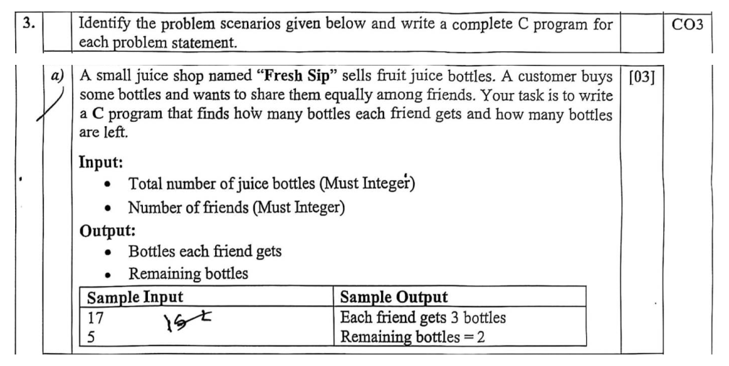
Programming and Problem Solving
Midterm
Q3(a) Sharing juice bottles
Batch 71
Summer 2026 (262) / Question
10 / 81
Notes:
Source: https://ourdiu.com/questions/472
Original submission 614
Complete question: Q3(a) Sharing juice bottles
The following slide provides space for live solving.

Slide 11
Programming and Problem Solving
Midterm
Q3(a) Sharing juice bottles
Batch 71
Working
Summer 2026 (262) / Live solving
11 / 81
Notes:
Source: https://ourdiu.com/questions/472
Q3(a) Sharing juice bottles
Use the blank area to explain the algorithm, trace variables, or write the solution live. For a larger view of the question, return to the preceding excerpt slide(s).

Slide 12
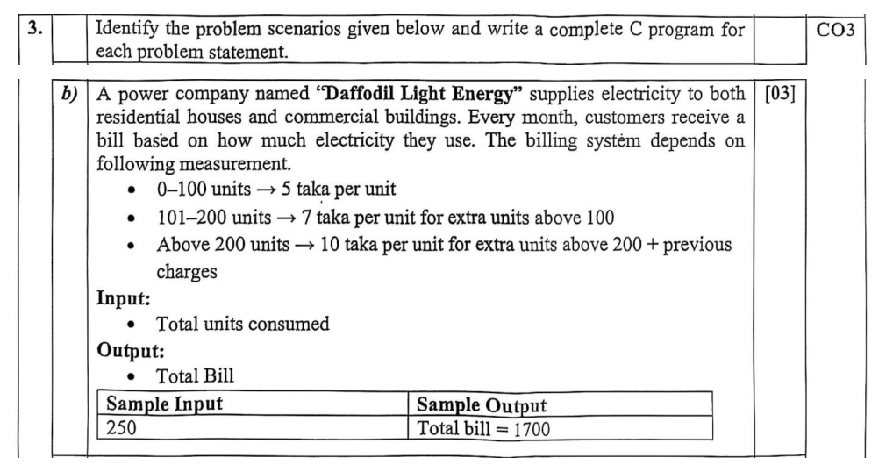
Programming and Problem Solving
Midterm
Q3(b) Electricity bill
Batch 71
Summer 2026 (262) / Question
12 / 81
Notes:
Source: https://ourdiu.com/questions/472
Original submission 614
Complete question: Q3(b) Electricity bill
The following slide provides space for live solving.

Slide 13
Programming and Problem Solving
Midterm
Q3(b) Electricity bill
Batch 71
Working
Summer 2026 (262) / Live solving
13 / 81
Notes:
Source: https://ourdiu.com/questions/472
Q3(b) Electricity bill
Use the blank area to explain the algorithm, trace variables, or write the solution live. For a larger view of the question, return to the preceding excerpt slide(s).

Slide 14
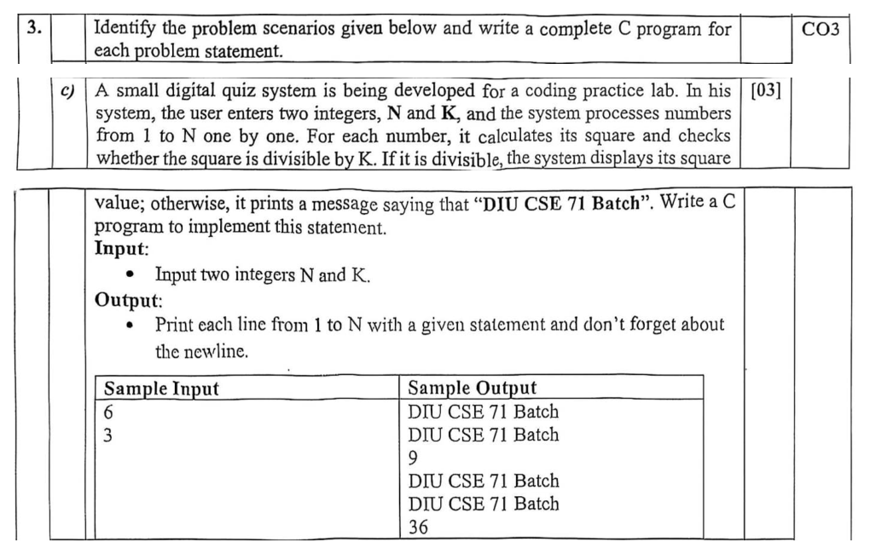
Programming and Problem Solving
Midterm
Q3(c) Squares and divisibility
Batch 71
Summer 2026 (262) / Question
14 / 81
Notes:
Source: https://ourdiu.com/questions/472
Original submission 614
Complete question: Q3(c) Squares and divisibility
The following slide provides space for live solving.

Slide 15
Programming and Problem Solving
Midterm
Q3(c) Squares and divisibility
Batch 71
Working
Summer 2026 (262) / Live solving
15 / 81
Notes:
Source: https://ourdiu.com/questions/472
Q3(c) Squares and divisibility
Use the blank area to explain the algorithm, trace variables, or write the solution live. For a larger view of the question, return to the preceding excerpt slide(s).

Slide 16
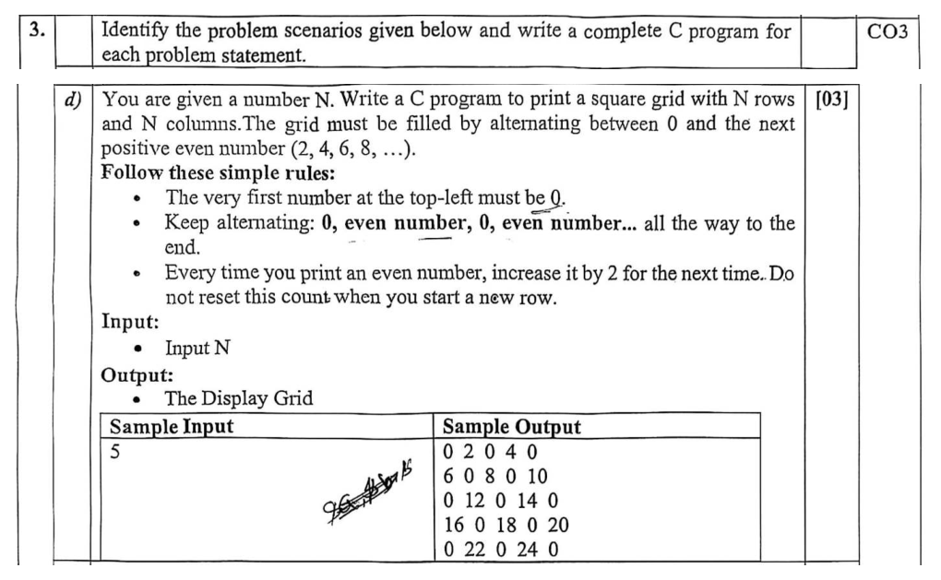
Programming and Problem Solving
Midterm
Q3(d) Alternating grid
Batch 71
Summer 2026 (262) / Question
16 / 81
Notes:
Source: https://ourdiu.com/questions/472
Original submission 614
Complete question: Q3(d) Alternating grid
The following slide provides space for live solving.

Slide 17
Programming and Problem Solving
Midterm
Q3(d) Alternating grid
Batch 71
Working
Summer 2026 (262) / Live solving
17 / 81
Notes:
Source: https://ourdiu.com/questions/472
Q3(d) Alternating grid
Use the blank area to explain the algorithm, trace variables, or write the solution live. For a larger view of the question, return to the preceding excerpt slide(s).

Slide 18
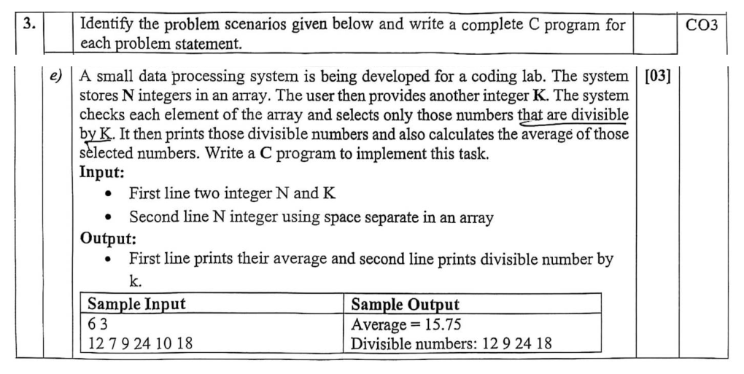
Programming and Problem Solving
Midterm
Q3(e) Divisible numbers and average
Batch 71
Summer 2026 (262) / Question
18 / 81
Notes:
Source: https://ourdiu.com/questions/472
Original submission 614
Complete question: Q3(e) Divisible numbers and average
The following slide provides space for live solving.

Slide 19
Programming and Problem Solving
Midterm
Q3(e) Divisible numbers and average
Batch 71
Working
Summer 2026 (262) / Live solving
19 / 81
Notes:
Source: https://ourdiu.com/questions/472
Q3(e) Divisible numbers and average
Use the blank area to explain the algorithm, trace variables, or write the solution live. For a larger view of the question, return to the preceding excerpt slide(s).

Slide 20
Spring 2026 (261)
-----------------------------------------------
Midterm Examination
Batch 70
20 / 81
Notes:
Source: https://ourdiu.com/questions/982
Original submission 1322
{"id":"legacy-228","username":"raiyan","name":"RAIYAN","image":"https://files.ourdiu.com/avatars/5129b054-12db-4ae5-b192-98b740c161a1"}

Slide 21
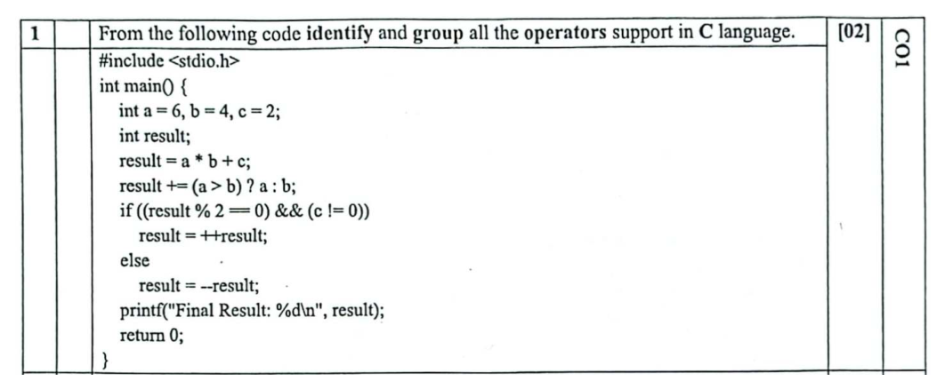
Programming and Problem Solving
Midterm
Q1 Operators
Batch 70
Spring 2026 (261) / Question
21 / 81
Notes:
Source: https://ourdiu.com/questions/982
Original submission 1322
Complete question: Q1 Operators
The following slide provides space for live solving.

Slide 22
Programming and Problem Solving
Midterm
Q1 Operators
Batch 70
Working
Spring 2026 (261) / Live solving
22 / 81
Notes:
Source: https://ourdiu.com/questions/982
Q1 Operators
Use the blank area to explain the algorithm, trace variables, or write the solution live. For a larger view of the question, return to the preceding excerpt slide(s).

Slide 23
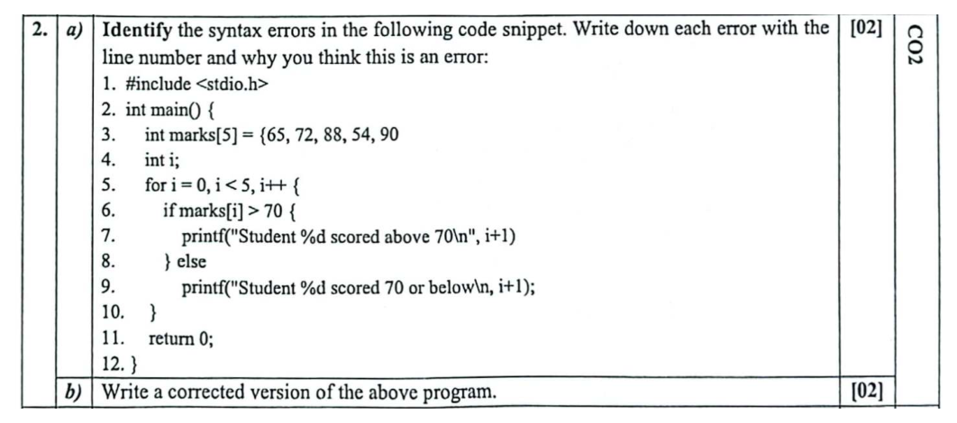
Programming and Problem Solving
Midterm
Q2(a-b) Errors and corrected code
Batch 70
Spring 2026 (261) / Question
23 / 81
Notes:
Source: https://ourdiu.com/questions/982
Original submission 1322
Complete question: Q2(a-b) Errors and corrected code
The following slide provides space for live solving.

Slide 24
Programming and Problem Solving
Midterm
Q2(a-b) Errors and corrected code
Batch 70
Working
Spring 2026 (261) / Live solving
24 / 81
Notes:
Source: https://ourdiu.com/questions/982
Q2(a-b) Errors and corrected code
Use the blank area to explain the algorithm, trace variables, or write the solution live. For a larger view of the question, return to the preceding excerpt slide(s).

Slide 25
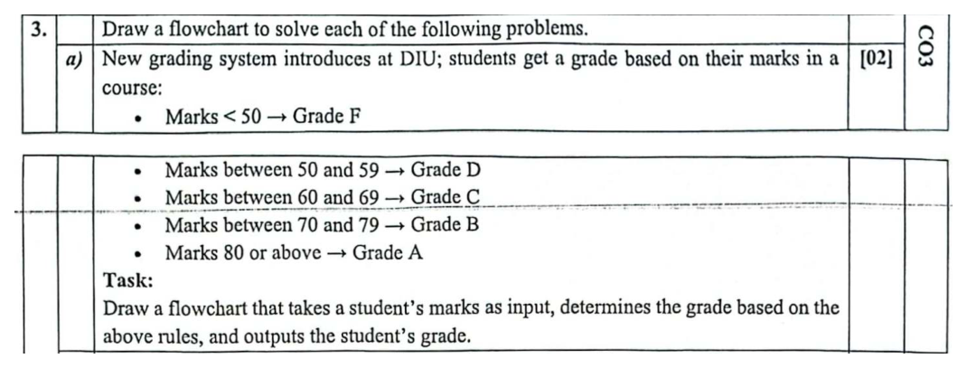
Programming and Problem Solving
Midterm
Q3(a) Grade calculation flowchart
Batch 70
Spring 2026 (261) / Question
25 / 81
Notes:
Source: https://ourdiu.com/questions/982
Original submission 1322
Complete question: Q3(a) Grade calculation flowchart
The following slide provides space for live solving.

Slide 26
Programming and Problem Solving
Midterm
Q3(a) Grade calculation flowchart
Batch 70
Working
Spring 2026 (261) / Live solving
26 / 81
Notes:
Source: https://ourdiu.com/questions/982
Q3(a) Grade calculation flowchart
Use the blank area to explain the algorithm, trace variables, or write the solution live. For a larger view of the question, return to the preceding excerpt slide(s).

Slide 27
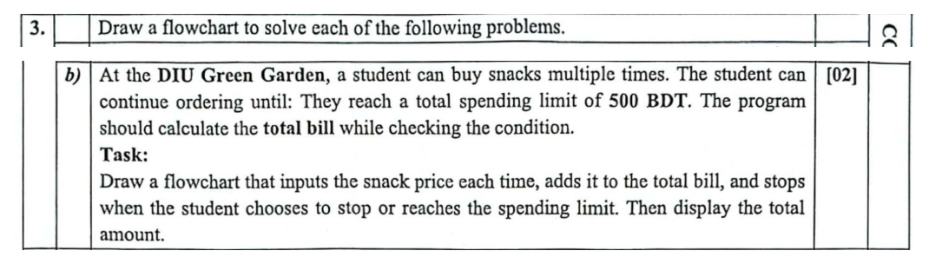
Programming and Problem Solving
Midterm
Q3(b) Canteen flowchart
Batch 70
Spring 2026 (261) / Question
27 / 81
Notes:
Source: https://ourdiu.com/questions/982
Original submission 1322
Complete question: Q3(b) Canteen flowchart
The following slide provides space for live solving.

Slide 28
Programming and Problem Solving
Midterm
Q3(b) Canteen flowchart
Batch 70
Working
Spring 2026 (261) / Live solving
28 / 81
Notes:
Source: https://ourdiu.com/questions/982
Q3(b) Canteen flowchart
Use the blank area to explain the algorithm, trace variables, or write the solution live. For a larger view of the question, return to the preceding excerpt slide(s).

Slide 29
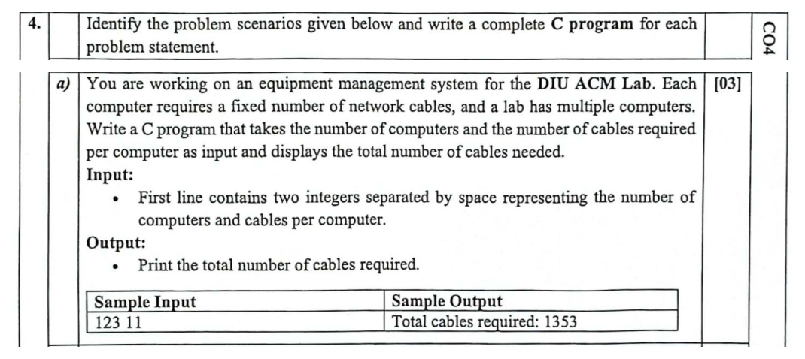
Programming and Problem Solving
Midterm
Q4(a) Computers and cables
Batch 70
Spring 2026 (261) / Question
29 / 81
Notes:
Source: https://ourdiu.com/questions/982
Original submission 1322
Complete question: Q4(a) Computers and cables
The following slide provides space for live solving.

Slide 30
Programming and Problem Solving
Midterm
Q4(a) Computers and cables
Batch 70
Working
Spring 2026 (261) / Live solving
30 / 81
Notes:
Source: https://ourdiu.com/questions/982
Q4(a) Computers and cables
Use the blank area to explain the algorithm, trace variables, or write the solution live. For a larger view of the question, return to the preceding excerpt slide(s).

Slide 31
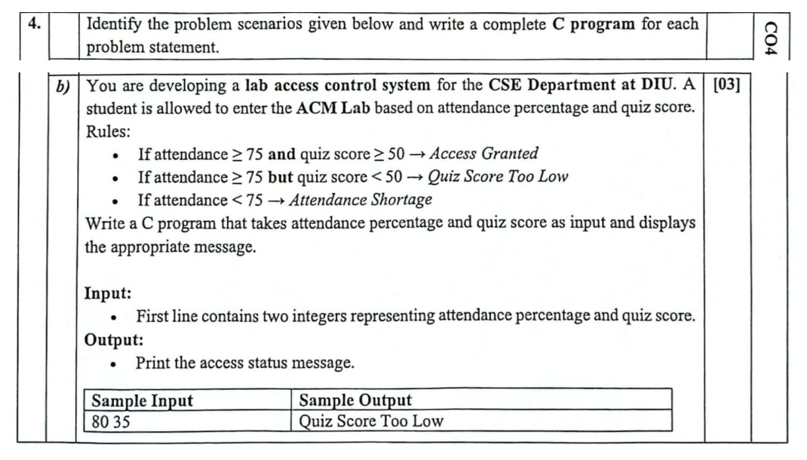
Programming and Problem Solving
Midterm
Q4(b) Lab access
Batch 70
Spring 2026 (261) / Question
31 / 81
Notes:
Source: https://ourdiu.com/questions/982
Original submission 1322
Complete question: Q4(b) Lab access
The following slide provides space for live solving.

Slide 32
Programming and Problem Solving
Midterm
Q4(b) Lab access
Batch 70
Working
Spring 2026 (261) / Live solving
32 / 81
Notes:
Source: https://ourdiu.com/questions/982
Q4(b) Lab access
Use the blank area to explain the algorithm, trace variables, or write the solution live. For a larger view of the question, return to the preceding excerpt slide(s).

Slide 33
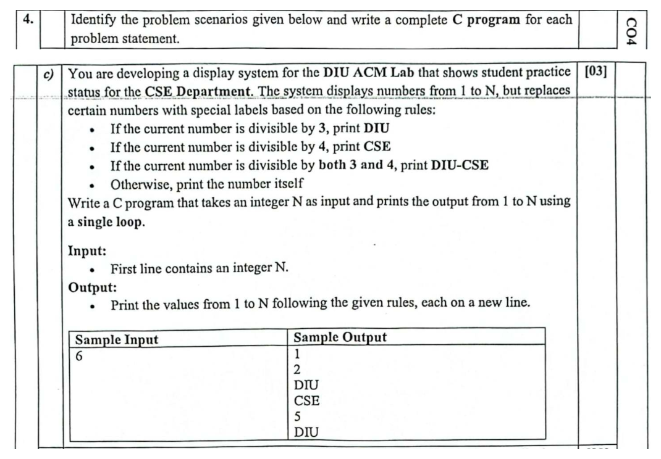
Programming and Problem Solving
Midterm
Q4(c) Number display
Batch 70
Spring 2026 (261) / Question
33 / 81
Notes:
Source: https://ourdiu.com/questions/982
Original submission 1322
Complete question: Q4(c) Number display
The following slide provides space for live solving.

Slide 34
Programming and Problem Solving
Midterm
Q4(c) Number display
Batch 70
Working
Spring 2026 (261) / Live solving
34 / 81
Notes:
Source: https://ourdiu.com/questions/982
Q4(c) Number display
Use the blank area to explain the algorithm, trace variables, or write the solution live. For a larger view of the question, return to the preceding excerpt slide(s).

Slide 35
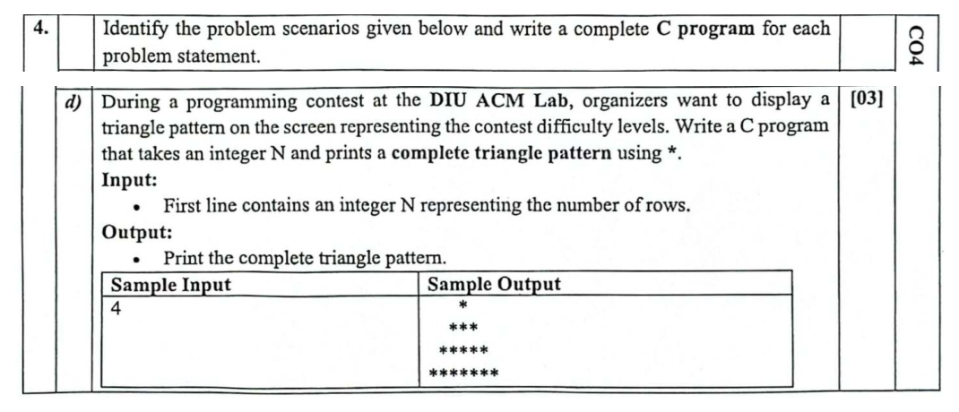
Programming and Problem Solving
Midterm
Q4(d) Triangle pattern
Batch 70
Spring 2026 (261) / Question
35 / 81
Notes:
Source: https://ourdiu.com/questions/982
Original submission 1322
Complete question: Q4(d) Triangle pattern
The following slide provides space for live solving.

Slide 36
Programming and Problem Solving
Midterm
Q4(d) Triangle pattern
Batch 70
Working
Spring 2026 (261) / Live solving
36 / 81
Notes:
Source: https://ourdiu.com/questions/982
Q4(d) Triangle pattern
Use the blank area to explain the algorithm, trace variables, or write the solution live. For a larger view of the question, return to the preceding excerpt slide(s).

Slide 37
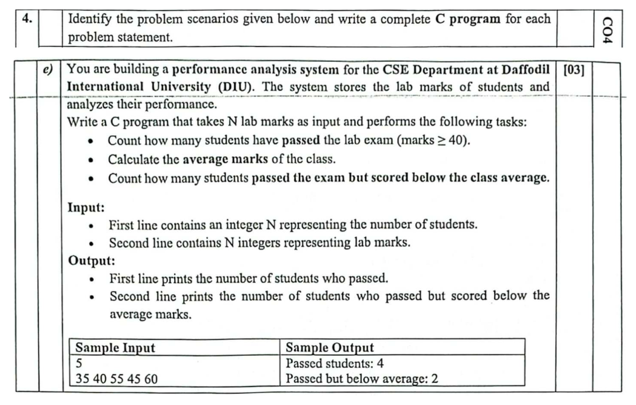
Programming and Problem Solving
Midterm
Q4(e) Lab performance
Batch 70
Spring 2026 (261) / Question
37 / 81
Notes:
Source: https://ourdiu.com/questions/982
Original submission 1322
Complete question: Q4(e) Lab performance
The following slide provides space for live solving.

Slide 38
Programming and Problem Solving
Midterm
Q4(e) Lab performance
Batch 70
Working
Spring 2026 (261) / Live solving
38 / 81
Notes:
Source: https://ourdiu.com/questions/982
Q4(e) Lab performance
Use the blank area to explain the algorithm, trace variables, or write the solution live. For a larger view of the question, return to the preceding excerpt slide(s).

Slide 39
Fall 2025 (253)
-----------------------------------------------
Midterm Examination
Batch 69
39 / 81
Notes:
Source: https://ourdiu.com/questions/1372
Original submission 1785
{"id":"legacy-150","username":"25215417","name":"Md. Mahfuzur Rahman","image":null}

Slide 40
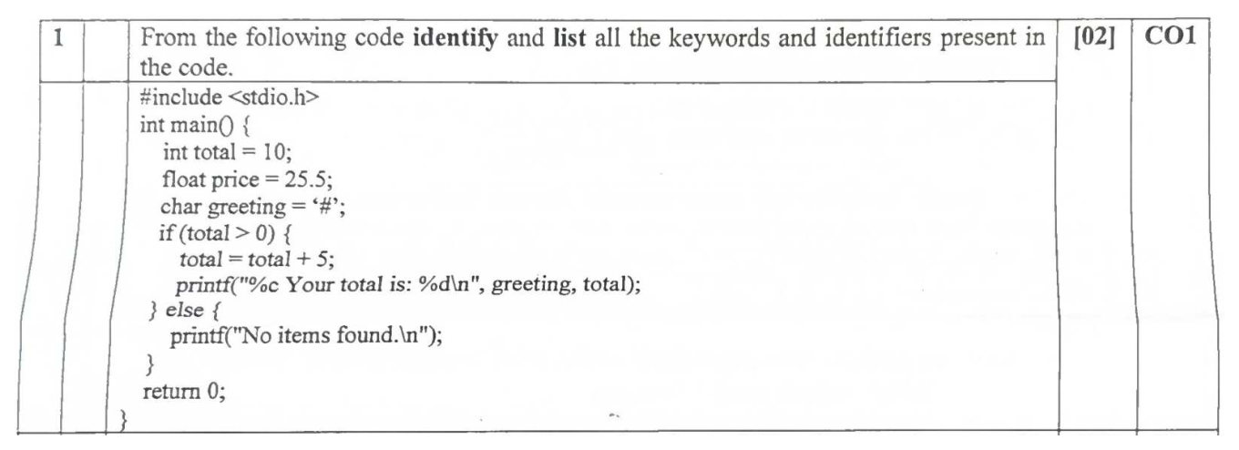
Programming and Problem Solving
Midterm
Q1 Keywords and identifiers
Batch 69
Fall 2025 (253) / Question
40 / 81
Notes:
Source: https://ourdiu.com/questions/1372
Original submission 1785
Complete question: Q1 Keywords and identifiers
The following slide provides space for live solving.

Slide 41
Programming and Problem Solving
Midterm
Q1 Keywords and identifiers
Batch 69
Working
Fall 2025 (253) / Live solving
41 / 81
Notes:
Source: https://ourdiu.com/questions/1372
Q1 Keywords and identifiers
Use the blank area to explain the algorithm, trace variables, or write the solution live. For a larger view of the question, return to the preceding excerpt slide(s).

Slide 42
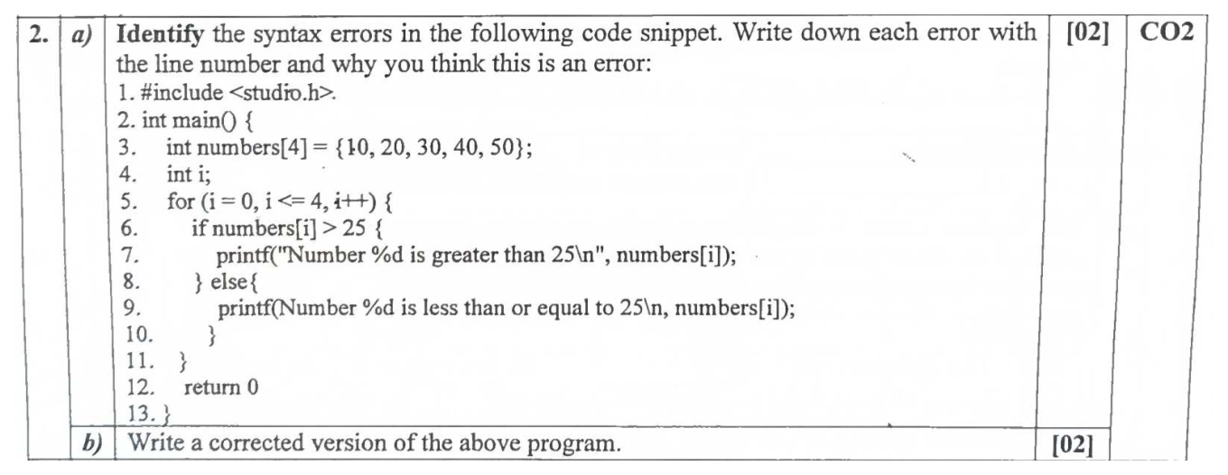
Programming and Problem Solving
Midterm
Q2(a-b) Errors and corrected code
Batch 69
Fall 2025 (253) / Question
42 / 81
Notes:
Source: https://ourdiu.com/questions/1372
Original submission 1785
Complete question: Q2(a-b) Errors and corrected code
The following slide provides space for live solving.

Slide 43
Programming and Problem Solving
Midterm
Q2(a-b) Errors and corrected code
Batch 69
Working
Fall 2025 (253) / Live solving
43 / 81
Notes:
Source: https://ourdiu.com/questions/1372
Q2(a-b) Errors and corrected code
Use the blank area to explain the algorithm, trace variables, or write the solution live. For a larger view of the question, return to the preceding excerpt slide(s).

Slide 44
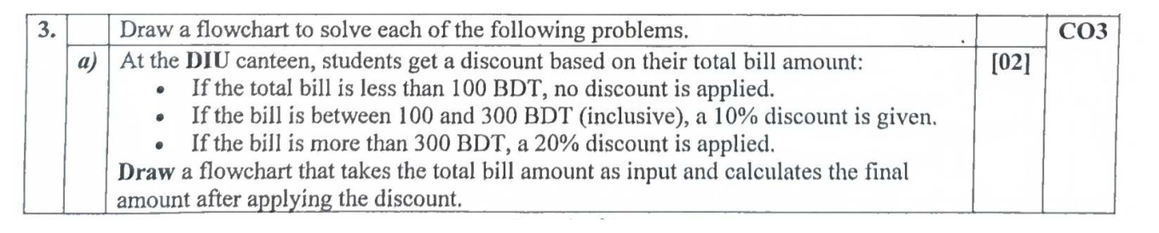
Programming and Problem Solving
Midterm
Q3(a) Canteen discount flowchart
Batch 69
Fall 2025 (253) / Question
44 / 81
Notes:
Source: https://ourdiu.com/questions/1372
Original submission 1785
Complete question: Q3(a) Canteen discount flowchart
The following slide provides space for live solving.

Slide 45
Programming and Problem Solving
Midterm
Q3(a) Canteen discount flowchart
Batch 69
Working
Fall 2025 (253) / Live solving
45 / 81
Notes:
Source: https://ourdiu.com/questions/1372
Q3(a) Canteen discount flowchart
Use the blank area to explain the algorithm, trace variables, or write the solution live. For a larger view of the question, return to the preceding excerpt slide(s).

Slide 46
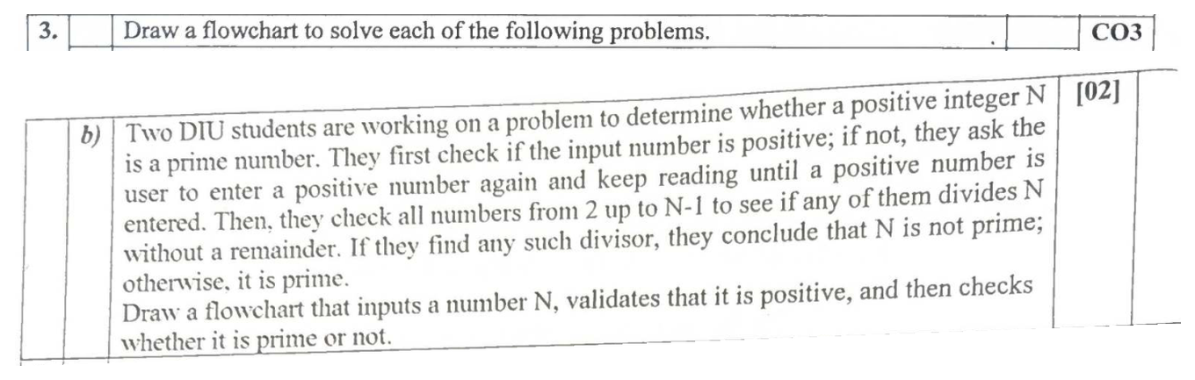
Programming and Problem Solving
Midterm
Q3(b) Prime number flowchart
Batch 69
Fall 2025 (253) / Question
46 / 81
Notes:
Source: https://ourdiu.com/questions/1372
Original submission 1785
Complete question: Q3(b) Prime number flowchart
The following slide provides space for live solving.

Slide 47
Programming and Problem Solving
Midterm
Q3(b) Prime number flowchart
Batch 69
Working
Fall 2025 (253) / Live solving
47 / 81
Notes:
Source: https://ourdiu.com/questions/1372
Q3(b) Prime number flowchart
Use the blank area to explain the algorithm, trace variables, or write the solution live. For a larger view of the question, return to the preceding excerpt slide(s).

Slide 48
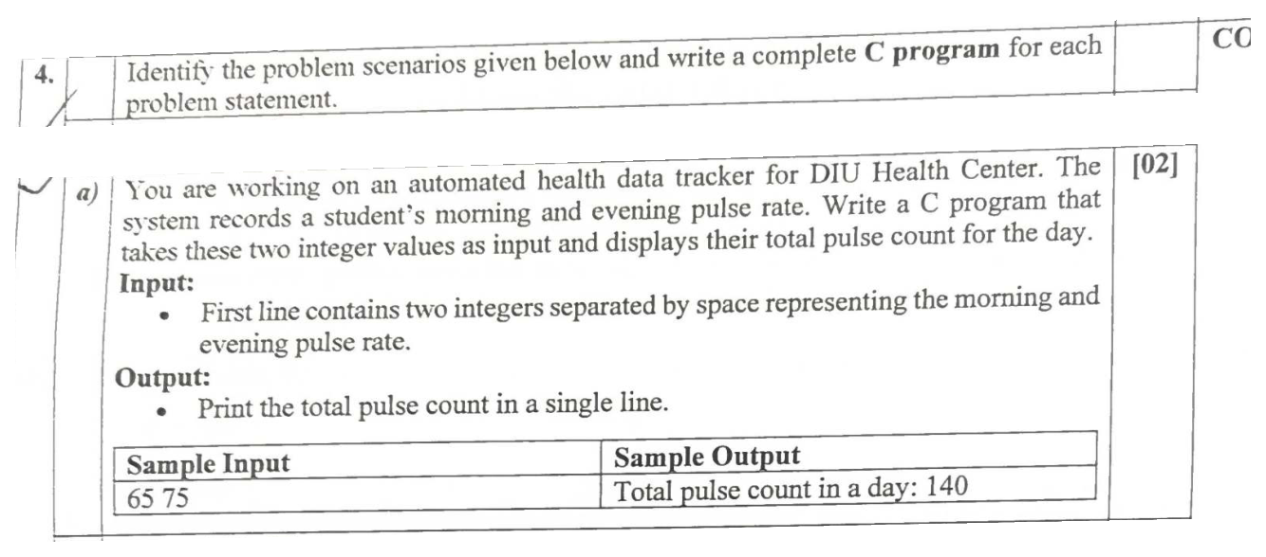
Programming and Problem Solving
Midterm
Q4(a) Pulse count
Batch 69
Fall 2025 (253) / Question
48 / 81
Notes:
Source: https://ourdiu.com/questions/1372
Original submission 1785
Complete question: Q4(a) Pulse count
The following slide provides space for live solving.

Slide 49
Programming and Problem Solving
Midterm
Q4(a) Pulse count
Batch 69
Working
Fall 2025 (253) / Live solving
49 / 81
Notes:
Source: https://ourdiu.com/questions/1372
Q4(a) Pulse count
Use the blank area to explain the algorithm, trace variables, or write the solution live. For a larger view of the question, return to the preceding excerpt slide(s).

Slide 50
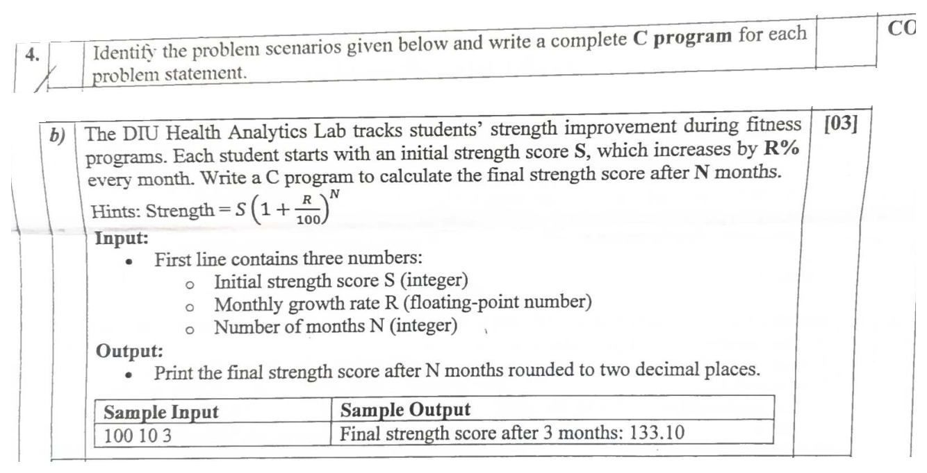
Programming and Problem Solving
Midterm
Q4(b) Strength improvement
Batch 69
Fall 2025 (253) / Question
50 / 81
Notes:
Source: https://ourdiu.com/questions/1372
Original submission 1785
Complete question: Q4(b) Strength improvement
The following slide provides space for live solving.

Slide 51
Programming and Problem Solving
Midterm
Q4(b) Strength improvement
Batch 69
Working
Fall 2025 (253) / Live solving
51 / 81
Notes:
Source: https://ourdiu.com/questions/1372
Q4(b) Strength improvement
Use the blank area to explain the algorithm, trace variables, or write the solution live. For a larger view of the question, return to the preceding excerpt slide(s).

Slide 52
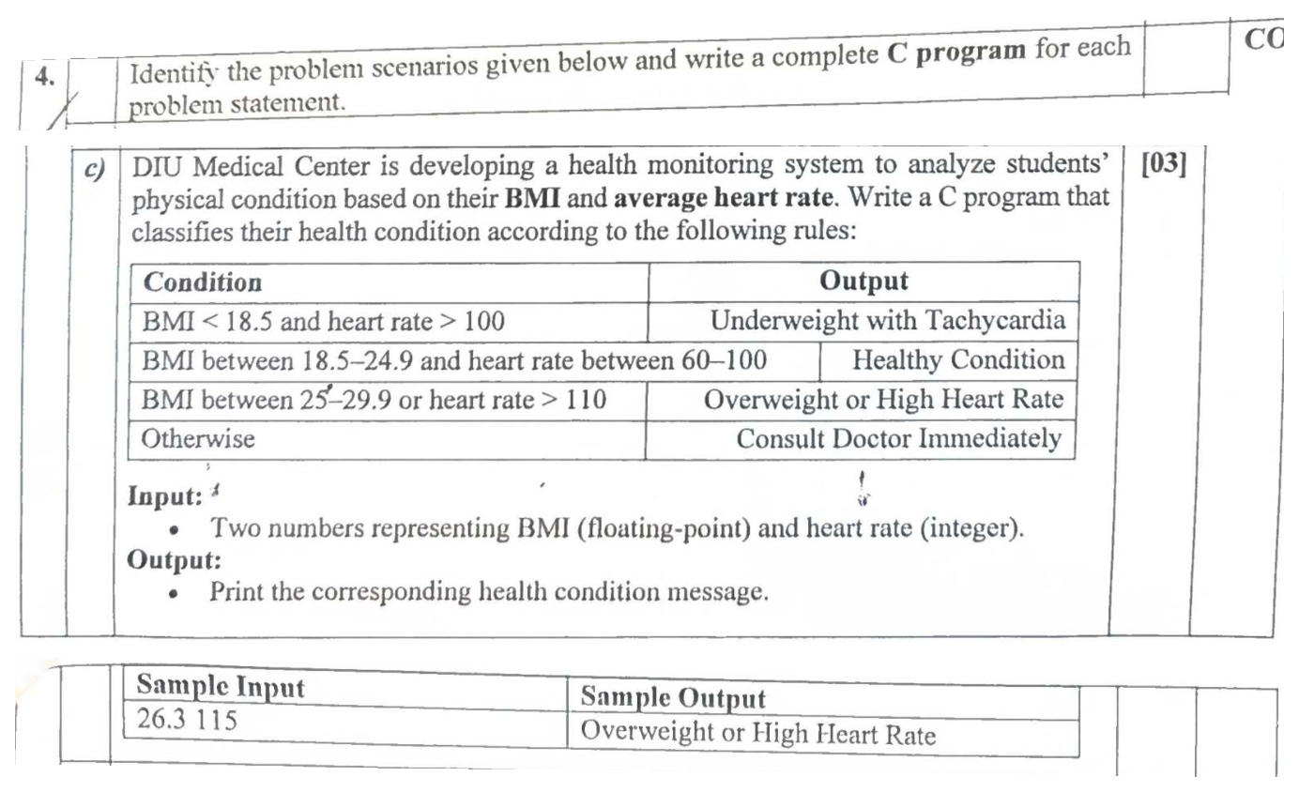
Programming and Problem Solving
Midterm
Q4(c) Health condition
Batch 69
Fall 2025 (253) / Question
52 / 81
Notes:
Source: https://ourdiu.com/questions/1372
Original submission 1785
Complete question: Q4(c) Health condition
The following slide provides space for live solving.

Slide 53
Programming and Problem Solving
Midterm
Q4(c) Health condition
Batch 69
Working
Fall 2025 (253) / Live solving
53 / 81
Notes:
Source: https://ourdiu.com/questions/1372
Q4(c) Health condition
Use the blank area to explain the algorithm, trace variables, or write the solution live. For a larger view of the question, return to the preceding excerpt slide(s).

Slide 54
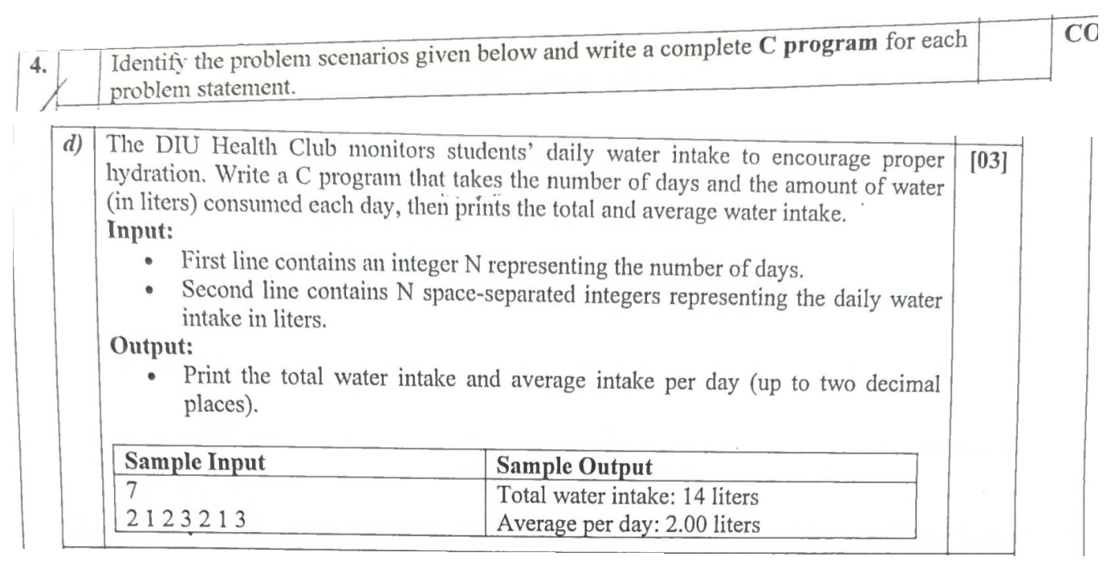
Programming and Problem Solving
Midterm
Q4(d) Water intake
Batch 69
Fall 2025 (253) / Question
54 / 81
Notes:
Source: https://ourdiu.com/questions/1372
Original submission 1785
Complete question: Q4(d) Water intake
The following slide provides space for live solving.

Slide 55
Programming and Problem Solving
Midterm
Q4(d) Water intake
Batch 69
Working
Fall 2025 (253) / Live solving
55 / 81
Notes:
Source: https://ourdiu.com/questions/1372
Q4(d) Water intake
Use the blank area to explain the algorithm, trace variables, or write the solution live. For a larger view of the question, return to the preceding excerpt slide(s).

Slide 56
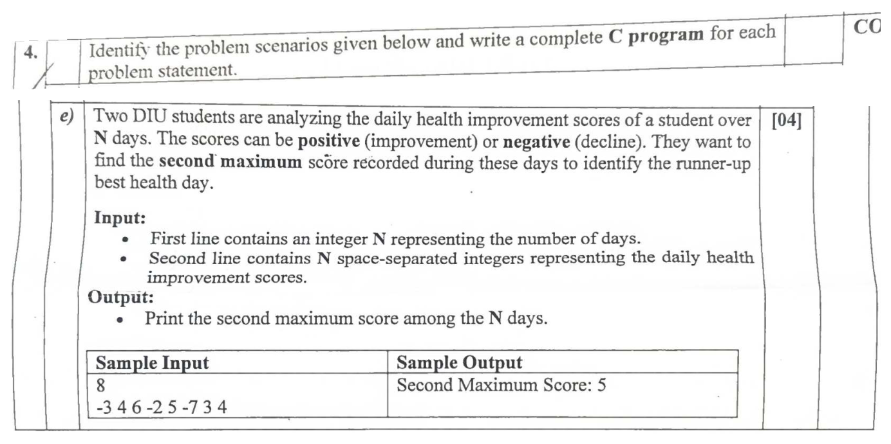
Programming and Problem Solving
Midterm
Q4(e) Second maximum
Batch 69
Fall 2025 (253) / Question
56 / 81
Notes:
Source: https://ourdiu.com/questions/1372
Original submission 1785
Complete question: Q4(e) Second maximum
The following slide provides space for live solving.

Slide 57
Programming and Problem Solving
Midterm
Q4(e) Second maximum
Batch 69
Working
Fall 2025 (253) / Live solving
57 / 81
Notes:
Source: https://ourdiu.com/questions/1372
Q4(e) Second maximum
Use the blank area to explain the algorithm, trace variables, or write the solution live. For a larger view of the question, return to the preceding excerpt slide(s).

Slide 58
Summer 2025 (252)
-----------------------------------------------
Midterm Examination
Batch 68
58 / 81
Notes:
Source: https://ourdiu.com/questions/812
Original submission 1972
{"id":"legacy-115","username":"251-15-210","name":"MD. Abdullah Al Fahim","image":"https://files.ourdiu.com/avatars/803de213-3968-449b-beed-71a92ae2b139"}

Slide 59
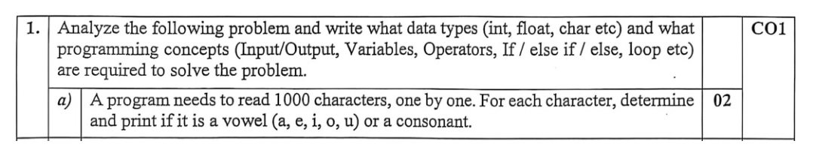
Programming and Problem Solving
Midterm
Q1 Data types and concepts
Batch 68
Summer 2025 (252) / Question
59 / 81
Notes:
Source: https://ourdiu.com/questions/812
Original submission 1972
Complete question: Q1 Data types and concepts
The following slide provides space for live solving.

Slide 60
Programming and Problem Solving
Midterm
Q1 Data types and concepts
Batch 68
Working
Summer 2025 (252) / Live solving
60 / 81
Notes:
Source: https://ourdiu.com/questions/812
Q1 Data types and concepts
Use the blank area to explain the algorithm, trace variables, or write the solution live. For a larger view of the question, return to the preceding excerpt slide(s).

Slide 61
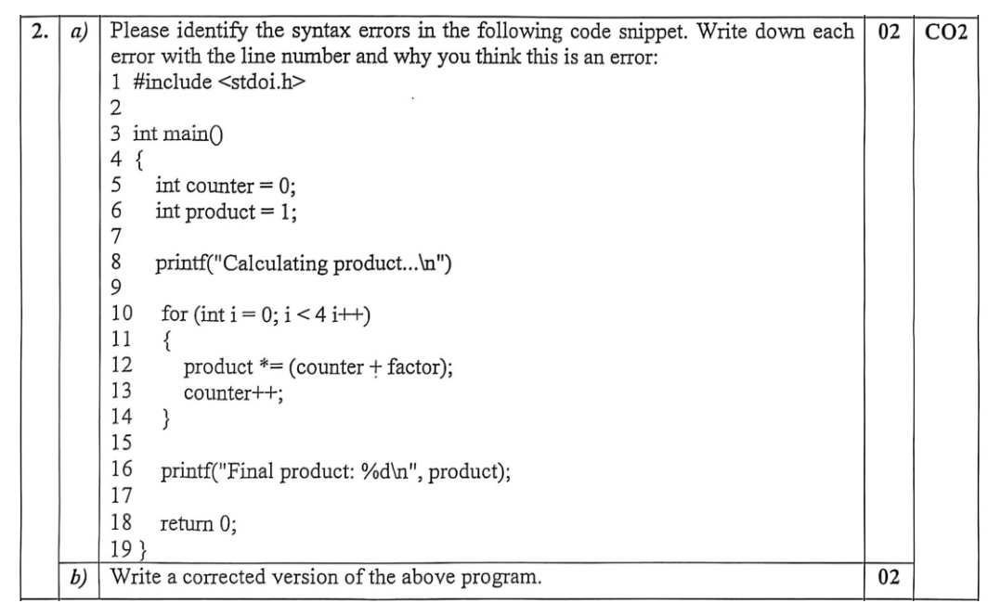
Programming and Problem Solving
Midterm
Q2(a-b) Errors and corrected code
Batch 68
Summer 2025 (252) / Question
61 / 81
Notes:
Source: https://ourdiu.com/questions/812
Original submission 1972
Complete question: Q2(a-b) Errors and corrected code
The following slide provides space for live solving.

Slide 62
Programming and Problem Solving
Midterm
Q2(a-b) Errors and corrected code
Batch 68
Working
Summer 2025 (252) / Live solving
62 / 81
Notes:
Source: https://ourdiu.com/questions/812
Q2(a-b) Errors and corrected code
Use the blank area to explain the algorithm, trace variables, or write the solution live. For a larger view of the question, return to the preceding excerpt slide(s).

Slide 63
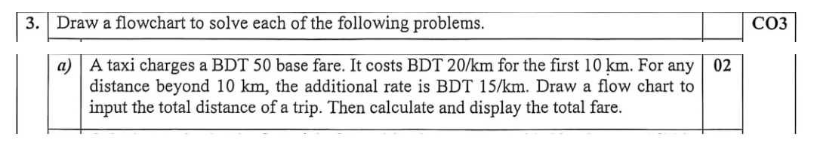
Programming and Problem Solving
Midterm
Q3(a) Taxi fare flowchart
Batch 68
Summer 2025 (252) / Question
63 / 81
Notes:
Source: https://ourdiu.com/questions/812
Original submission 1972
Complete question: Q3(a) Taxi fare flowchart
The following slide provides space for live solving.

Slide 64
Programming and Problem Solving
Midterm
Q3(a) Taxi fare flowchart
Batch 68
Working
Summer 2025 (252) / Live solving
64 / 81
Notes:
Source: https://ourdiu.com/questions/812
Q3(a) Taxi fare flowchart
Use the blank area to explain the algorithm, trace variables, or write the solution live. For a larger view of the question, return to the preceding excerpt slide(s).

Slide 65
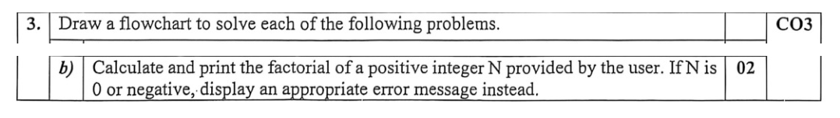
Programming and Problem Solving
Midterm
Q3(b) Factorial flowchart
Batch 68
Summer 2025 (252) / Question
65 / 81
Notes:
Source: https://ourdiu.com/questions/812
Original submission 1972
Complete question: Q3(b) Factorial flowchart
The following slide provides space for live solving.

Slide 66
Programming and Problem Solving
Midterm
Q3(b) Factorial flowchart
Batch 68
Working
Summer 2025 (252) / Live solving
66 / 81
Notes:
Source: https://ourdiu.com/questions/812
Q3(b) Factorial flowchart
Use the blank area to explain the algorithm, trace variables, or write the solution live. For a larger view of the question, return to the preceding excerpt slide(s).

Slide 67
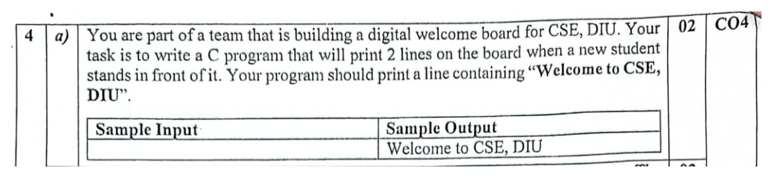
Programming and Problem Solving
Midterm
Q4(a) Welcome message
Batch 68
Summer 2025 (252) / Question
67 / 81
Notes:
Source: https://ourdiu.com/questions/812
Original submission 1972
Complete question: Q4(a) Welcome message
The following slide provides space for live solving.

Slide 68
Programming and Problem Solving
Midterm
Q4(a) Welcome message
Batch 68
Working
Summer 2025 (252) / Live solving
68 / 81
Notes:
Source: https://ourdiu.com/questions/812
Q4(a) Welcome message
Use the blank area to explain the algorithm, trace variables, or write the solution live. For a larger view of the question, return to the preceding excerpt slide(s).

Slide 69
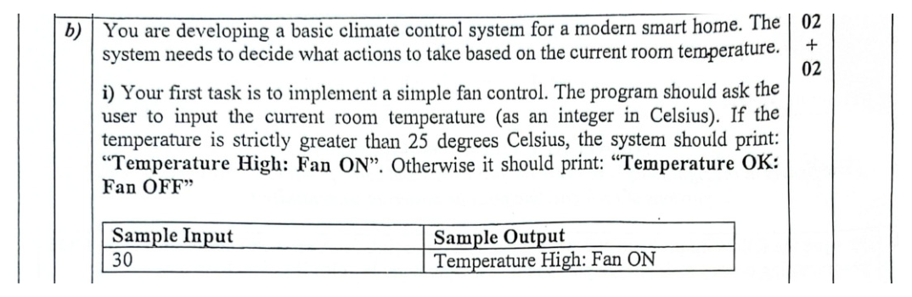
Programming and Problem Solving
Midterm
Q4(b-i) Fan control
Batch 68
Summer 2025 (252) / Question
69 / 81
Notes:
Source: https://ourdiu.com/questions/812
Original submission 1972
Complete question: Q4(b-i) Fan control
The following slide provides space for live solving.

Slide 70
Programming and Problem Solving
Midterm
Q4(b-i) Fan control
Batch 68
Working
Summer 2025 (252) / Live solving
70 / 81
Notes:
Source: https://ourdiu.com/questions/812
Q4(b-i) Fan control
Use the blank area to explain the algorithm, trace variables, or write the solution live. For a larger view of the question, return to the preceding excerpt slide(s).

Slide 71
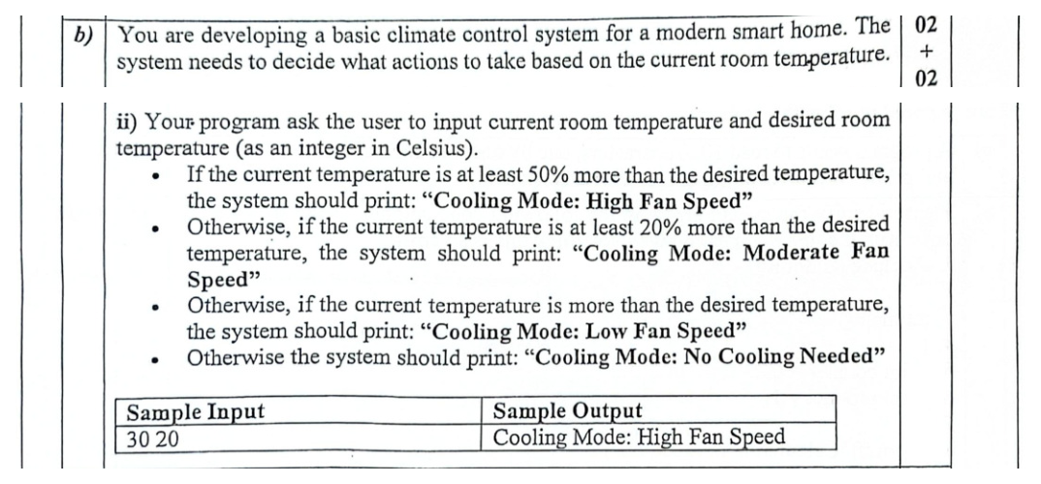
Programming and Problem Solving
Midterm
Q4(b-ii) Cooling mode
Batch 68
Summer 2025 (252) / Question
71 / 81
Notes:
Source: https://ourdiu.com/questions/812
Original submission 1972
Complete question: Q4(b-ii) Cooling mode
The following slide provides space for live solving.

Slide 72
Programming and Problem Solving
Midterm
Q4(b-ii) Cooling mode
Batch 68
Working
Summer 2025 (252) / Live solving
72 / 81
Notes:
Source: https://ourdiu.com/questions/812
Q4(b-ii) Cooling mode
Use the blank area to explain the algorithm, trace variables, or write the solution live. For a larger view of the question, return to the preceding excerpt slide(s).

Slide 73
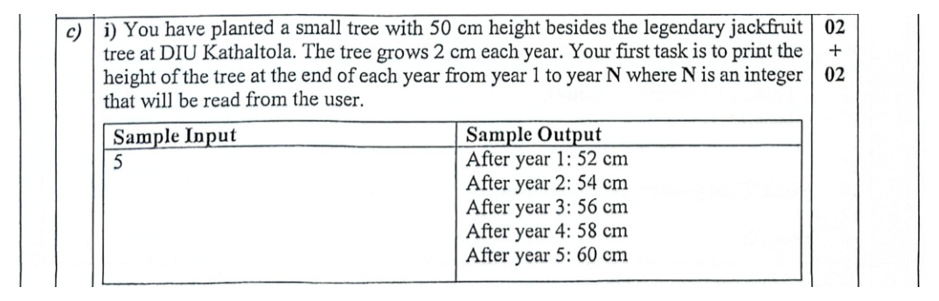
Programming and Problem Solving
Midterm
Q4(c-i) Tree growth
Batch 68
Summer 2025 (252) / Question
73 / 81
Notes:
Source: https://ourdiu.com/questions/812
Original submission 1972
Complete question: Q4(c-i) Tree growth
The following slide provides space for live solving.

Slide 74
Programming and Problem Solving
Midterm
Q4(c-i) Tree growth
Batch 68
Working
Summer 2025 (252) / Live solving
74 / 81
Notes:
Source: https://ourdiu.com/questions/812
Q4(c-i) Tree growth
Use the blank area to explain the algorithm, trace variables, or write the solution live. For a larger view of the question, return to the preceding excerpt slide(s).

Slide 75
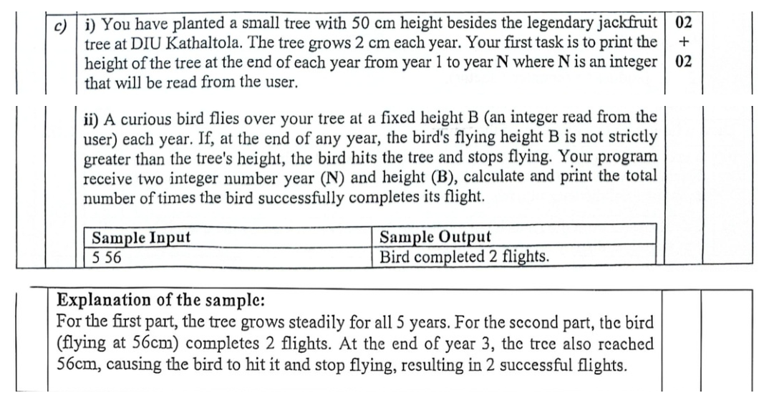
Programming and Problem Solving
Midterm
Q4(c-ii) Bird flights
Batch 68
Summer 2025 (252) / Question
75 / 81
Notes:
Source: https://ourdiu.com/questions/812
Original submission 1972
Complete question: Q4(c-ii) Bird flights
The following slide provides space for live solving.

Slide 76
Programming and Problem Solving
Midterm
Q4(c-ii) Bird flights
Batch 68
Working
Summer 2025 (252) / Live solving
76 / 81
Notes:
Source: https://ourdiu.com/questions/812
Q4(c-ii) Bird flights
Use the blank area to explain the algorithm, trace variables, or write the solution live. For a larger view of the question, return to the preceding excerpt slide(s).

Slide 77
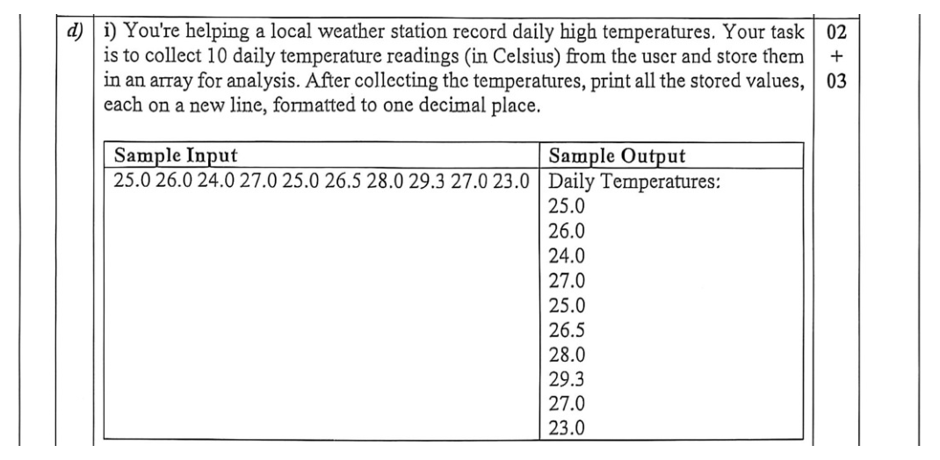
Programming and Problem Solving
Midterm
Q4(d-i) Temperature readings
Batch 68
Summer 2025 (252) / Question
77 / 81
Notes:
Source: https://ourdiu.com/questions/812
Original submission 1972
Complete question: Q4(d-i) Temperature readings
The following slide provides space for live solving.

Slide 78
Programming and Problem Solving
Midterm
Q4(d-i) Temperature readings
Batch 68
Working
Summer 2025 (252) / Live solving
78 / 81
Notes:
Source: https://ourdiu.com/questions/812
Q4(d-i) Temperature readings
Use the blank area to explain the algorithm, trace variables, or write the solution live. For a larger view of the question, return to the preceding excerpt slide(s).

Slide 79
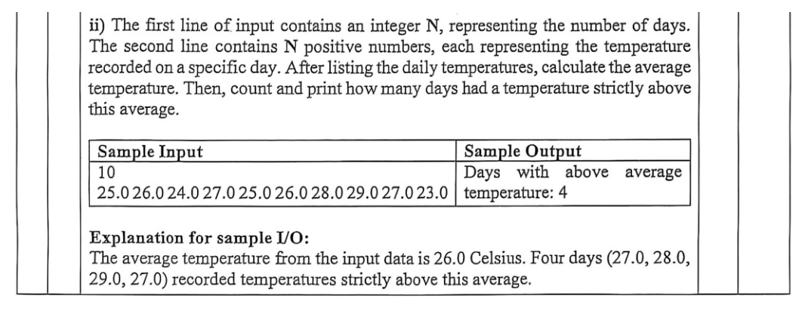
Programming and Problem Solving
Midterm
Q4(d-ii) Days above average
Batch 68
Summer 2025 (252) / Question
79 / 81
Notes:
Source: https://ourdiu.com/questions/812
Original submission 1972
Complete question: Q4(d-ii) Days above average
The following slide provides space for live solving.

Slide 80
Programming and Problem Solving
Midterm
Q4(d-ii) Days above average
Batch 68
Working
Summer 2025 (252) / Live solving
80 / 81
Notes:
Source: https://ourdiu.com/questions/812
Q4(d-ii) Days above average
Use the blank area to explain the algorithm, trace variables, or write the solution live. For a larger view of the question, return to the preceding excerpt slide(s).

Slide 81
Thank You
81 / 81

